Slide 1

Blockchains
& Distributed Ledgers
Lecture 07
Aggelos Kiayias
Slide credits: AK, Dimitris Karakostas, Dionysis Zindros, Christos Nasikas, Aikaterini-Panagiota Stouka

Slide 2
[Previously]
Participating in a blockchain/distributed ledger system requires
Electricity expenditure
Hardware equipment
Network availability
Security analysis so far: participants are either honest 😇 or adversarial 😈
Honest parties follow the protocol precisely
Adversarial (corrupted) parties can follow any algorithm they want
If majority of power (computational/stake) is honest, then the ledger is secure
Persistence and liveness are guaranteed

Slide 3
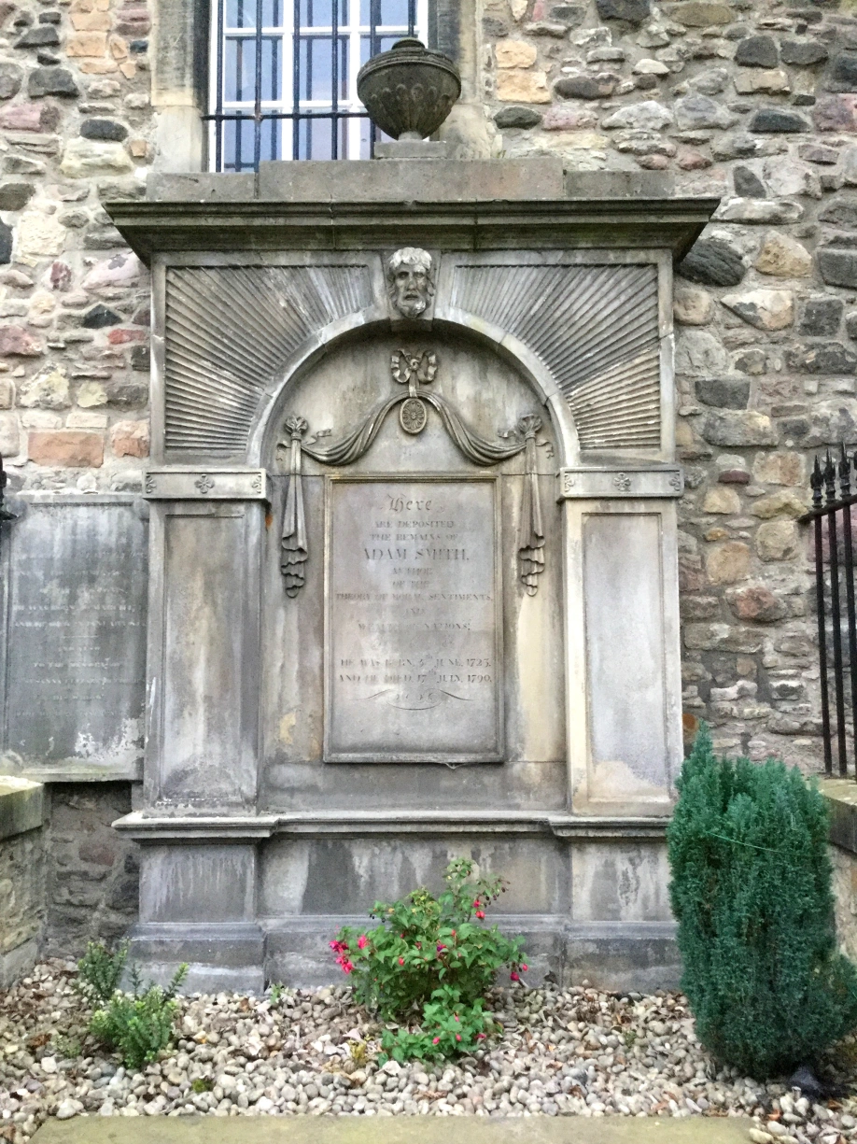
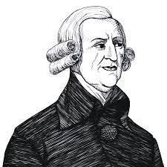
Adam Smith (1723-1790)

Slide 4
The capitalist principle
The invisible hand of the market
“he intends only his own gain; and he is in this, as in many other cases, led by an invisible hand to promote an end which was no part of his intention” (Adam Smith. The Wealth of Nations.)
People chase after their own profit…
… and in doing so can, seemingly inadvertently, create external results that are positive overall
For example, the baker is adept in making bread, and he does so efficiently, selling it for money, in this way feeding the families that buy it

Slide 5
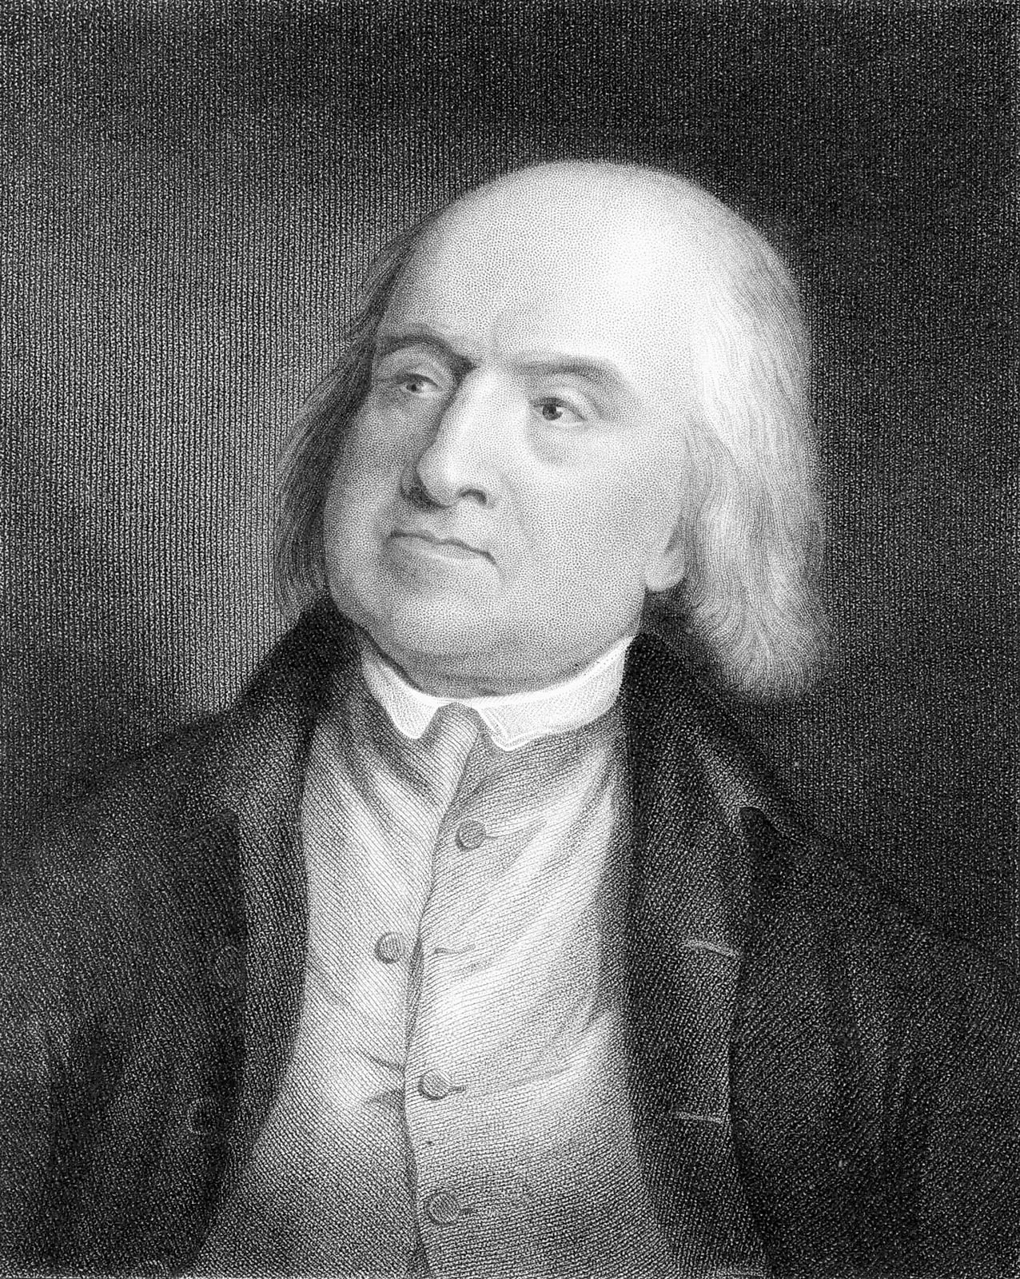
Jeremy Bentham (1748-1832)

Slide 6
Utilitarianism
The principle of utility
“that property in any object, whereby it tends to produce benefit, advantage, pleasure, good, or happiness” (Jeremy Bentham. An Introduction to the Principles of Morals and Legislation)
Utility: the property that each person strives to maximize
Money: people try to increase their financial wealth
Social acceptance: people try to increase their fame or status
Divine acceptance: people try to act as close as possible to what their religion dictates

Slide 7
From the invisible hand to incentives
People have some utility
In the capitalist system, the utility is monetary profit
Therefore, profit seeking is the rational behavior
Every player is motivated to always maximize their own profit
How to design a system s.t. rational parties follow the prescribed protocol?

Slide 8
The economics of consensus
Running a consensus protocol involves multiple participants with possibly conflicting interests
What if participants, instead of being honest/malicious, instead follow their best financial interest?
How are participants incentivized to engage?
Are the desired properties of distributed ledgers (consistency, liveness) the result of the participants’ rational engagement?

Slide 9
Bitcoin Incentives

Slide 10
Mining incentives
A miner is incentivized to mine in 2 ways:
Transaction Fees
(Fixed) Block Rewards

Slide 11
Mining fees
[Recall] A transaction defines inputs and outputs
Value conservation law:
<sum of input values> ≥ <sum of output values>
No amount value is created by a simple transaction
Transaction fees: the remaining money from the conservation law of value
tx_fees = Σ_{i ∈ in(tx)} w(i) - Σ_{o ∈ out(tx)} w(o), where w(.) is value
Each transaction’s fees are claimed by the miner who included the respective transaction in their block

Slide 12
Mining block rewards
A miner is given a fixed reward per block they create
The only way to create new coins
In 2024 Bitcoin: 3.125 BTC
The block reward and the transaction fees are claimed by the miner via a coinbase transaction
Example:
aggregate tx fees = 0.5 BTC
block reward = 6.25 BTC
value of coinbase tx output = 6.75 BTC

Slide 13
The coinbase transaction
The coinbase transaction is the transaction by which a miner is paid their rewards (tx fees + fixed block reward)
There can only be one coinbase transaction per block
It is the first transaction that appears in the block
It has no inputs
This is the only way new bitcoins are generated
6.75 BTC
miner

Slide 14
The coinbase transaction
As it does not have any inputs, a coinbase tx’s scriptSig can be anything
scriptSig is used for certain block metadata:
The block height (verified for validity)
The name of the mining pool/user that mined the block
Extra entropy (nonce)
Signalling for protocol updates (whether a miner is in favour of an upgrade or not, e.g., a hard fork)

Slide 15
Coinbase transaction validity
[Recall] A tx consumes existing outputs (UTxOs) and creates new UTxOs
The induction step
Coinbase tx is the induction basis for transaction validity
Has no inputs, so does not conform to the conservation law of value.
Is not part of the mempool
only included in blocks directly
When a Bitcoin block is confirmed, the coinbase is checked for validity:
It is the first in the block
There’s only one of it
output value ≤ block reward + block tx fees
A malicious miner cannot generate more money (than determined by Bitcoin’s monetary policy protocol)

Slide 16
Money supply in Bitcoin
The money supply in Bitcoin is algorithmically predetermined
Upper-capped total amount of tokens
Sometimes compared to “digital gold”
Achieved with an algorithm known beforehand to all
Concretely:
The coinbase of genesis has reward 50 BTC
Each next block has reward equal to its previous block
Every 210,000 blocks (on expectation: 4 years), the reward is halved
The duration during which rewards stay the same is known as an era

Slide 17
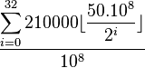
Money supply in Bitcoin
era duration in blocks
number of eras until reward is negligible
genesis block reward
Total number of bitcoins that will ever
be mined:
10⁸ satoshi = bitcoin

Slide 18
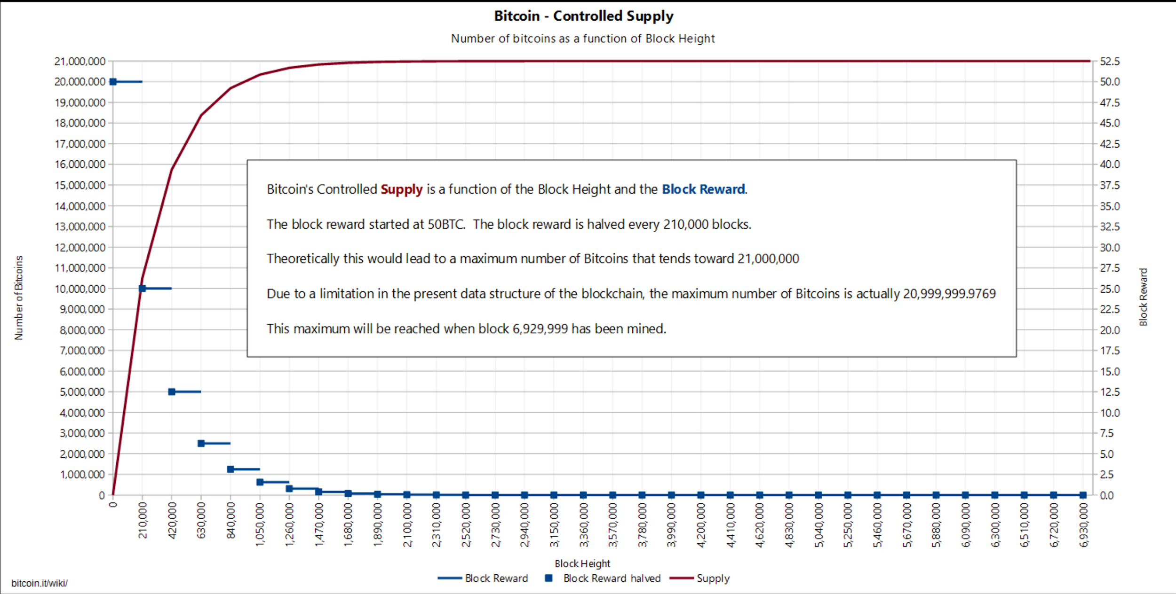
we are here
https://en.bitcoin.it/wiki/Controlled_supply

Slide 19
Money distribution in Bitcoin
Halving mechanism favors disproportionately the early miners
50% of all bitcoins that will ever be produced were created in first 3 years
Extremely centralized ownership distribution
(2013) 2,300 addresses controlled 50% of all tokens
(2022) 2,021 addresses (0.0047%) control 41% of all tokens
In the (extremely unequal) real world, 520,000 people (0.01%) control 11% of all wealth
(2022) Bitcoin Gini coefficient w.r.t. all addresses: 0.956
The worst real-world economy (in terms of Gini): 0.512
https://bitinfocharts.com/top-100-richest-bitcoin-addresses.html
Notes:
Total BTC: 20.99999998 million
End: year 2140

Slide 20
Bitcoin denominations
1 bitcoin is divisible up to 10⁻⁸
10⁻⁸ bitcoin = 1 satoshi
1 satoshi = 0.00000001 BTC
1 BTC = 100,000,000
The bitcoin implementation stores integers in the outputs, representing the number of satoshis
no floating-point errors

Slide 21
Ways to mine
CPU: standard processors
GPU: graphics card (high parallelization)
ASIC: specialized hardware for mining

Slide 22
Is it profitable to mine? Probably not...
https://www.nicehash.com/profitability-calculator
Electricity: $0.2/kwh Bitcoin: $20,000
October 2024:
CPU Intel i7-8700K:
Initial hardware cost: $170
Profit: -$0.22 / day
GPU NVIDIA GTX 1050 Ti:
Initial hardware cost: $150
Profit: -$0.26 / day
Specialized hardware AntMiner S17+:
Initial hardware cost: $1,500
Profit: -$10.34 / day
AntMiner L9:
Initial hardware cost: $8,000
Profit: $17.71 / day
November 2022:
CPU Intel i7-8700K:
Initial hardware cost: $360
Profit: -$0.23 / day
GPU NVIDIA GTX 1050 Ti:
Initial hardware cost: $160
Profit: -$0.26 / day
Specialized hardware AntMiner S17+:
Initial hardware cost: $1,500
Profit: -$8.49 / day
AntMiner Z15:
Initial hardware cost: $5,600
Profit: $0.59 / day
Even in 2013:
A high-end (24/7 running) Nvidia GPU could yield in practice 1BTC (~$100) in 6 months

Slide 23
Mining Games
Miners are incentivised (via rewards) to follow the protocol
Does this ensure that they choose to execute the protocol as described? (aka honest / truthful behavior)
Is the reward mechanism “incentive compatible”?
Protocol can be
Dominant strategy
Nash equilibrium

Slide 24
Dominant Strategy example
Cooperate or Defect Game (payoff table: <payoff of A> / <payoff of B>)
 | Cooperate (B) | Defect (B)
Cooperate (A) | modest / modest | zero / max
Defect (A) | max / zero | minimal / minimal

Slide 25
Dominant Strategy example
Cooperate or Defect Game (payoff table: <payoff of A> / <payoff of B>)
 | Cooperate (B) | Defect (B)
Cooperate (A) | modest / modest | zero / max
Defect (A) | max / zero | small / small
Defecting is dominant strategy
For player A: max > modest (if B cooperates), minimal > zero (if B defects)
Same for B
… but Defect/Defect is sub-optimal strategy profile
Since Cooperate/Cooperate yields higher rewards for both
See : prisoner’s dilemma two prisoners cooperate⬄stay silent, defect⬄testify, utilities are inverse.

Slide 26
Nash Equilibrium

Slide 27

John Forbes Nash Jr. (1928-2015)

Slide 28
Nash Equilibrium
Utility of a participant:
function
input: a vector of strategies of all participants
output: a real number that represents the gains of this participant at the end of the execution
Participants are rational:
they want to maximize the utility they obtain at the end of the execution

Slide 29
Nash Equilibrium
All participants are rational; they want to maximize their utility.
Π
Reward: 1000
Π
Π
Π
Π

Slide 30
Nash Equilibrium
All participants are rational; they want to maximize their utility. Nash Equilibrium: No party can increase its utility by deviating from Π.
Π
Π
Reward: 1000
Reward: 800
Π
Π
Σ ≠ Π
Π
Π
Π
Π
Π

Slide 31
Equilibrium in the Cooperate/Defect game
Cooperate or Defect Game (payoff table: <payoff of A> / <payoff of B>)
 | Cooperate (B) | Defect (B)
Cooperate (A) | modest / modest | zero / max
Defect (A) | max / zero | small / small
(Defect, Defect) is a Nash Equilibrium
For player A: U(Cooperate, Defect) = zero < small = U(Defect, Defect)
Same for B
(Cooperate, Cooperate) is not a Nash Equilibrium
For player A: U(Cooperate, Cooperate) = modest < max = U(Defect, Cooperate)
See : prisoner’s dilemma two prisoners cooperate⬄stay silent, defect⬄testify, utilities are inverse.

Slide 32
Generalisation to Coalitions
All participants are rational; they want to maximize their utility. Nash Equilibrium: No coalition can increase its aggregate utility by deviating from Π.
Reward: 2000
Reward:1900
Π
Σ₂ ≠ Π
Π
Π
Σ₁ ≠ Π
Π
Π
Π
Π
Π

Slide 33
Is Bitcoin a Nash Equilibrium ?
What can be the utility in Bitcoin?
Absolute rewards
Relative rewards
How can utility be defined in a probabilistic protocol?
expectation
events of high probability

Slide 34
Absolute Rewards, I
Fix:
the algorithms followed by all the participants
the outcome of all the randomness used by participants
a time limit (finite execution) of the Bitcoin protocol
Obtain a unique outcome of the protocol
Each block of the adopted chain gives a reward to its producer
genesis

Slide 35
Absolute Rewards, II
Absolute rewards: The utility of a coalition is equal to the number of BTC that it has obtained at the end of the execution
U_{i} = <sum rewards of P_{i}>

Slide 36
Absolute Rewards, III
2*50 = 100BTC
genesis

Slide 37
Relative Rewards, I
Relative Rewards: The utility of a coalition in Bitcoin is equal to the amount of BTC that it earns, divided by the total amount of BTC that all participants receive at the end of the execution
U_{i} = <sum rewards of P_{i}> / <sum rewards of all parties>

Slide 38
Relative Rewards, II
2*50
____
5*50
genesis

Slide 39
Utility in probabilistic protocols
Given the strategies of all the participants, the outcome of the Bitcoin execution is a random variable
The utility of a coalition (parameterized by an execution) is also a random variable
How to resolve this?
expectation that determines the expected value of utility
events that happen with high probability

Slide 40
Bitcoin and Equilibria
A certain modelling of the Bitcoin protocol is a Nash equilibrium
Utility is equal to expected number of absolute rewards
Block difficulty is fixed
Expected number of blocks is proportional to mining power (delivered by a Bitcoin execution)
Bitcoin is not a Nash equilibrium w.r.t relative rewards
Utility is equal to expected number of relative rewards
Block difficulty is fixed
Expected number of blocks is proportional to mining power (delivered by a Bitcoin execution)
Selfish mining strategy is more profitable
Kroll et al. in “The economics of Bitcoin mining, or Bitcoin in the presence of adversaries” (2013)
Ittay Eyal and Emin Gün Sirer. "Majority is not enough: Bitcoin mining is vulnerable."(2014)

Slide 41
Game Theoretic Attacks

Slide 42
Selfish Mining
A strategy that enables a coalition to collect more (expected) relative rewards by deviating from the honest protocol
Attacker maintains a private chain, strategically releasing its blocks to deny honest parties’ blocks from being adopted to the “main chain”

Slide 43
Selfish Mining, step 1
A adopts the longest chain and tries to extend it.
genesis
The public ledger

Slide 44
Selfish Mining, step 2a
A produces a block before the honest parties.
genesis
The public ledger

Slide 45
Selfish Mining, step 2a
A produces a block before the honest parties.
A keeps the block private…
genesis
The public ledger
Private block

Slide 46
Selfish Mining, step 2a
*Depending on the attacker’s network dominance, A might publish it when the honest chain is one block behind.
A produces a block before the honest parties.
A keeps the block private… until a competing honest block is created.*
genesis
The public ledger

Slide 47
Selfish Mining, step 2a
*Depending on the attacker’s network dominance, A might publish it when the honest chain is one block behind.
A produces a block before the honest parties.
A keeps the block private… until a competing honest block is created.*
If the other parties adopt the adversarial block, selfish mining attack is successful.
genesis
The public ledger

Slide 48
Selfish Mining, step 2b
The honest parties produce a block before A.
genesis
The public ledger

Slide 49
Selfish Mining, step 2b
The honest parties produce a block before A.
A adopts the block and goes to step 1.
genesis
The public ledger

Slide 50
Selfish Mining
More generally: A will be capable of censoring blocks, if
A’s chain gets two blocks ahead of the public chain
A manages to deliver its block to the other parties first
In principle, when an honest party receives two chains of the same length, it chooses the first that it received

Slide 51
Selfish Mining, Analysis
A contributes only towards censoring blocks and not towards extending the public ledger
During the attack, the total (expected) number of blocks in the public ledger is less than the expected number of blocks when A follows the protocol
If A does not manage to deliver its block first, A loses the block’s rewards
However, it is assumed that A has some control over the message delivery schedule

Slide 52
Selfish Mining, Analysis
Consider an execution that consists of “block rounds"
Assume that A always wins the network race vs. public blocks
A has probability α to produce the next block:
Honest play:
n rounds → n blocks
attacker creates αᐧn blocks in expectation
Utility: (Relative Rewards) = α, (Absolute Rewards) = αᐧn

Slide 53
Selfish Mining, Analysis
Consider an execution that consists of “block rounds"
Assume that A always wins the network race vs. public blocks
A has probability α to produce the next block:
Honest play:
n rounds → n blocks
attacker creates αᐧn blocks in expectation
Utility: (Relative Rewards) = α, (Absolute Rewards) = αᐧn
Selfish play:
n rounds → (1-α)ᐧn blocks
attacker creates αᐧn of those blocks
Utility: (Relative Rewards) = α / (1-α), (Absolute Rewards) = αᐧn
In a static difficulty setting absolute rewards are unaffected... but relative rewards increase!

Slide 54
Bitcoin and Equilibria, III
If difficulty adjusts…
Selfish mining will impact chain growth
The difficulty recalculation mechanism will lower the difficulty
Block production per actual unit of time will increase
Attacker will also receive higher number of (absolute) rewards compared to honest play

Slide 55
Block Reward Zero Attack
When the block reward becomes zero, incentives come only from tx fees
The following deviation may be profitable:
When a miner receives two blocks of the same height, instead of choosing the first one it chooses the block that leaves the most transaction fees unclaimed
A selfish miner can take advantage of this deviation by creating a fork with a block with less transaction fees than the block in the head of the public ledger
The attacker sacrifices part of their tx fees to attract others to join the fork
Carlsten, Miles, et al. "On the instability of bitcoin without the block reward." ( 2016)

Slide 56
Bribery Attack
The attacker creates a fork and includes in the first block a transaction τ₀ that gives bribe money to miners who will adopt the fork and will extend this block
The input of τ₀ is also transmitted in the public ledger and double spends the bribe money
If the chain of the attacker does not become longer than the public ledger then the attacker does not lose the bribe money
In this case, miners who adopted this fork will have spent computational power without gaining anything
Bonneau, Joseph, et al. "Why buy when you can rent? bribery attacks on Bitcoin consensus." (2016).

Slide 57
Mining Pools

Slide 58
Mining pools
Mining
gives a high reward per block
has a small probability of success
variance is high
Miners typically collaborate in mining pools
temporal discounting: the tendency to disfavor rare or delayed rewards
“I prefer to get $1,600 per month than $80,000 after 4 years”
If a miner in a pool finds a block, rewards are split among the pool members
Splitting is pro rata according to the computational power contributed by each
Miners outside of pools (very rare) are called solo
Pools are maintained by a trusted pool leader
Notes:
E.g., today around 60000 pounds.

Slide 59
Mining inside a pool
The pool maintains a different internal target for proof-of-work T_{pool} > T_{bitcoin}
If a block satisfies T_{bitcoin} < H(B) < T_{pool}, it is called a share
The miners of the pool mine as follows:
They include a coinbase tx with output the pool leader’s address
If H(B) < T_{bitcoin} , they broadcast the block to the bitcoin network
If H(B) < T_{pool}, they broadcast the share inside the pool
Pool leader verifies shares by:
Checking that PoW is satisfied with T_{pool}
Checking that coinbase tx pays to the pool’s address and not some other address

Slide 60
Pool rewarding
When a bitcoin block is created, each node in the pool is rewarded proportionally to the pool blocks they have recently generated
Node participants pay a participation fee to the pool leader
Pools are a trusted scheme:
Miners trust the pool leader, but the pool leader does not trust the miners
Miners don’t trust the other miners in the pool
The pool leader can steal money, but they will be detected
Why can’t a pool miner mine shares with the pool’s address, but blocks with their own address?
They don’t know if it will be a share or a block during mining!
After mining is completed, changing the address will invalidate the PoW.

Slide 61
Mining Pool Games
To create a pool or join an existing one? To switch between pools or stay in the same?
Assuming cost of verification and pool maintenance is non-negligible:
Optimal solution is a single dictatorial pool
Reason: offset costs with the player that has the lowest service cost

Slide 62
Block withholding attack
Consider there exists just two pools A, B with hashing power α and β resp.
A segment of pool A (α’) “infiltrates” pool B:
participates in pooled mining
receives rewards
does not share the solutions it finds
Assuming no other deviations, over a period of n steps:
Pool A will produce (α-α’)*n blocks.
Pool B will produce β*n blocks (same as before)
In the same period of time, the shares of pool B will be distributed as follows:
Members of pool A will obtain α’ / (β+α’) of such shares
Members of pool B will obtain β / (β+α’) of such shares
Pool A’s rewards in n steps are (α-α’)n + β n α’/(β+α’) of total rewards (α - α’ + β) n, relative ((α-α’)+ βα’/(β+α’)) / (α-α’+β)
In terms of relative rewards, this is better than α/(α+β) (from honest behaviour)

Slide 63
Real-world Utility

Slide 64
Real utility ≠ Cryptocurrency utility
The previous analyses measure utility in terms of BTC received
Real utility depends also on the exchange rate (price) BTC/USD, BTC/GBP and other real-world (fiat) currencies
Miners’ costs (e.g., energy bills) are in real-world money, not cryptocurrency
Market friction (e.g., exchange fees) may further impact real utility
Detectable deviations from the protocol may impact the price
If the protocol is perceived to be insecure or attackable → demand for BTC and trust in the network drops → BTC price drops → miner’s utility drops → counter-incentive to deviation
however, historical data show that the market typically does not respond in such manner (price does not drop significantly after an attack)

Slide 65
Will parties attack their own system?
Detectable deviations from the protocol may impact the price
If the protocol is perceived to be insecure or attackable
demand for token and trust in the network drops
→ price drops
→ miner’s (or stakeholder’s) utility drops
Miners may be dis-incentivized to attack
This argument is even more present in PoS, where participation is via the tokens themselves
However, historical data show that the market does not respond adequately
Prices don’t drop significantly after an attack
E.g., Ethereum Classic suffered two double-spending attacks in August 2020 and its price remained practically unaffected

